Slide 1
Unleashing the Power of Power BI: Key Insights and Best
Practices

Slide 2

Introduction
Welcome to the world of Power BI! In this presentation, we will explore the key insights and best practices to unleash its power. Get ready to dive into the world of data visualization and analysis.

Slide 3

Understanding Power BI
Power BI is a business intelligence tool by Microsoft that enables users to analyze data and share insights. It offers a user- friendly interface, powerful data manipulation capabilities, and seamless integration with other Microsoft tools.
Unlock the potential of your data with Power BI!

Slide 4

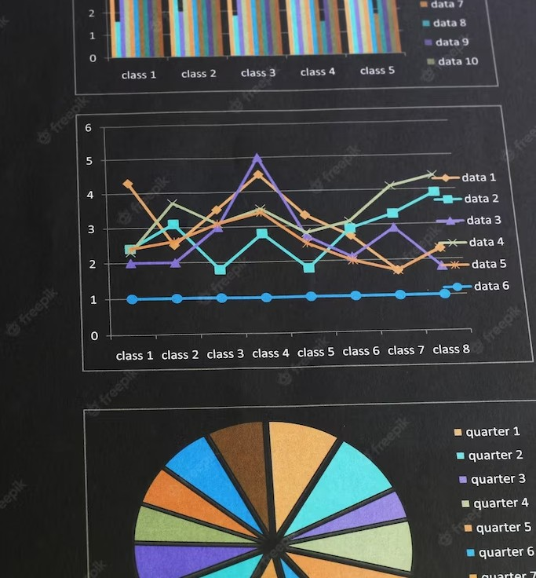
Data Visualization Best Practices
Visualizing data effectively is essential for impactful insights. Choose the right chart types for your data, ensure clarity with proper labeling and formatting, and use colors strategically to highlight key information. Remember, simplicity and consistency are key to engaging visualizations.

Slide 5

Data Preparation Tips
Preparing your data is crucial for accurate analysis. Cleanse and transform your data to remove errors and inconsistencies.
Utilize Power BI's built-in data shaping tools and apply data modeling techniques like creating relationships and calculated columns to enhance the quality of your data.

Slide 6

Interactive Dashboards and Reports
Create interactive dashboards and reports that enable users to explore data on their own. Utilize Power BI's interactive features like slicers, ﬁlters, and drill- through to provide a seamless and intuitive user experience. Empower your audience to make data-driven decisions.

Slide 7

Conclusion
Congratulations! You've gained valuable insights into unleashing the power of Power BI. Remember to follow best practices, visualize data effectively, and continuously reﬁne your analysis. By harnessing the power of Power BI, you can transform raw data into meaningful and actionable insights.

Slide 8
Thanks

Slide 9
Project
Investing.com

Slide 10
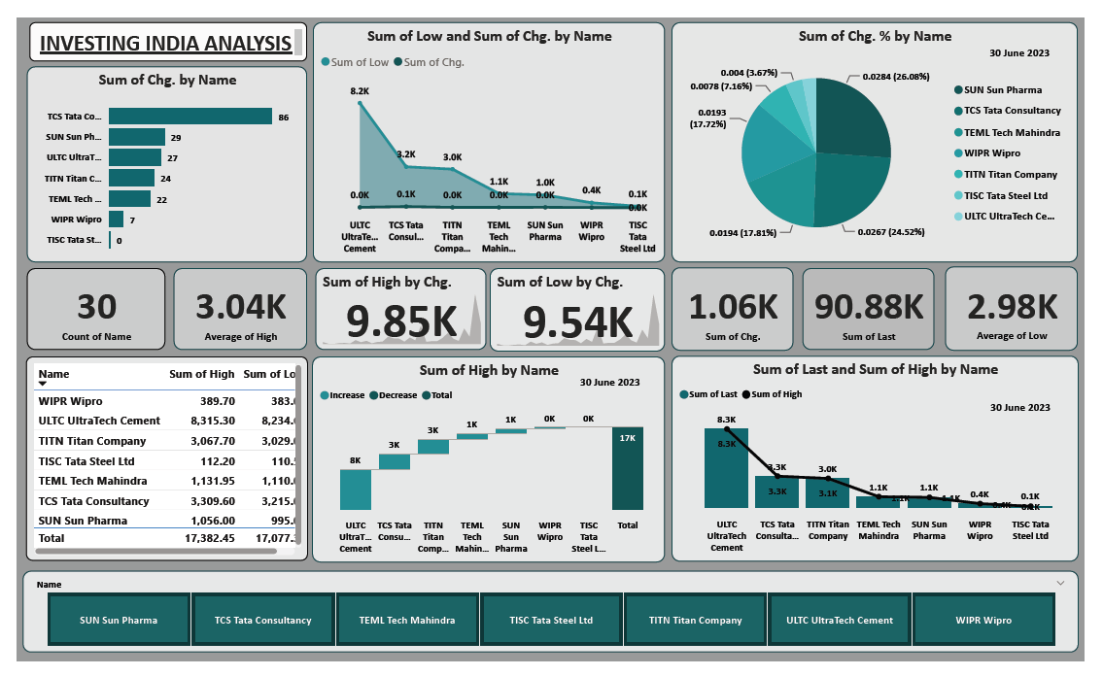

Slide 11
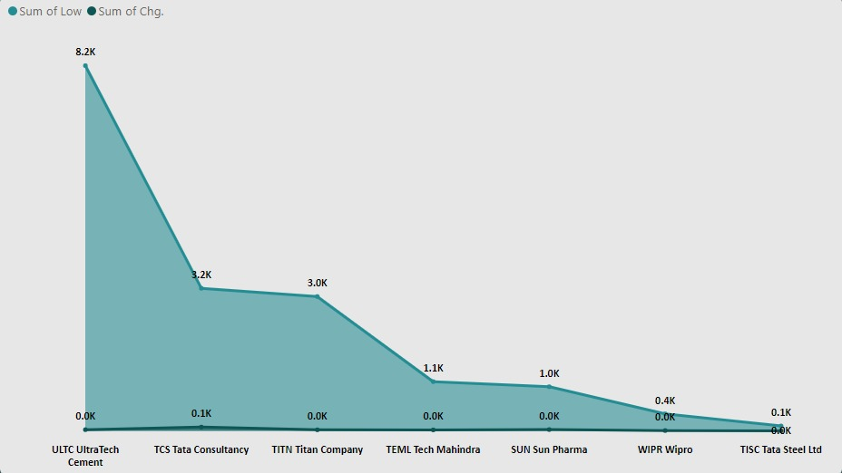
Area Chart

Slide 12
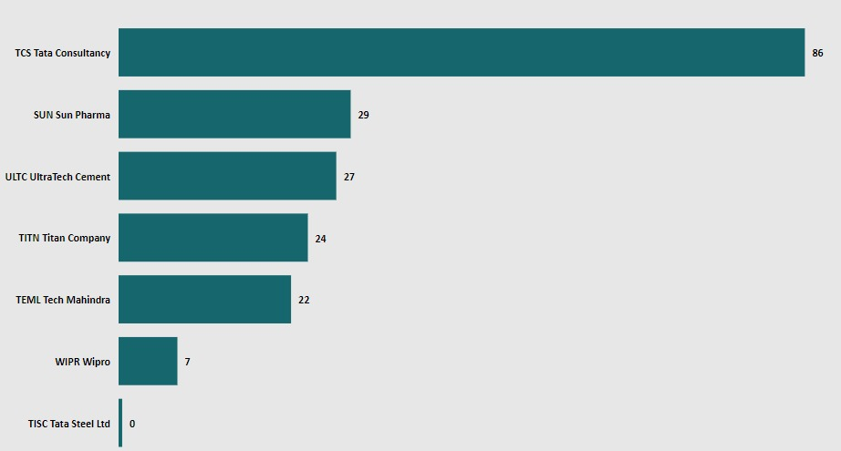
Clustered Bar Chart

Slide 13
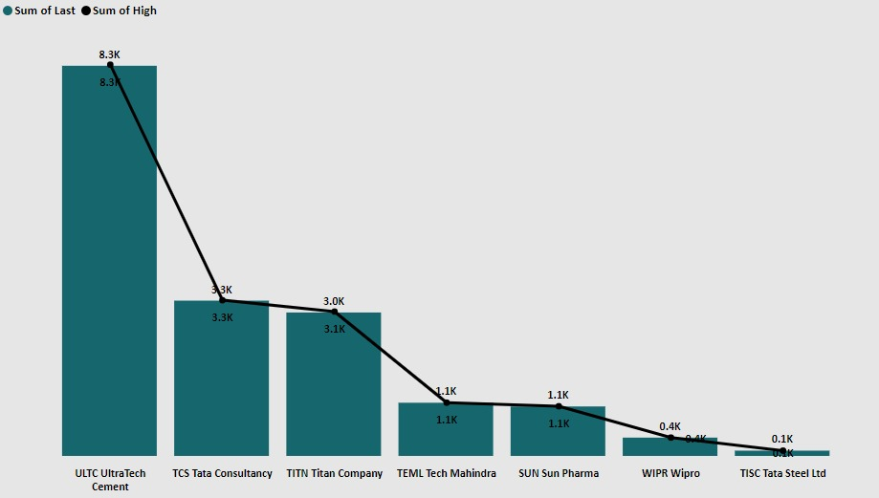
Line and Stacked columns chart

Slide 14
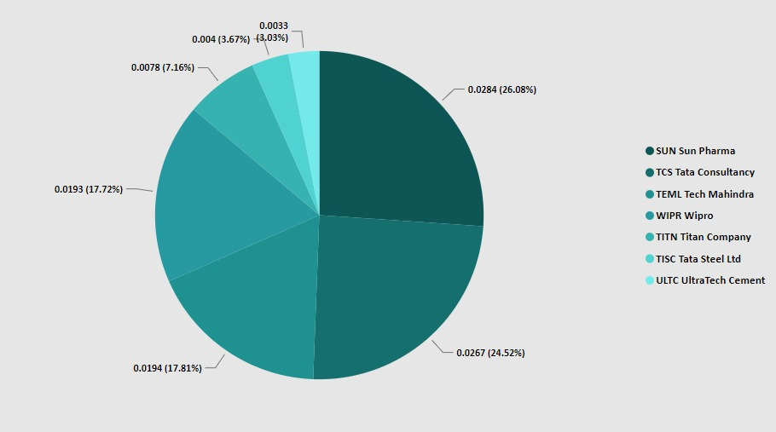
Pie Chart

Slide 15
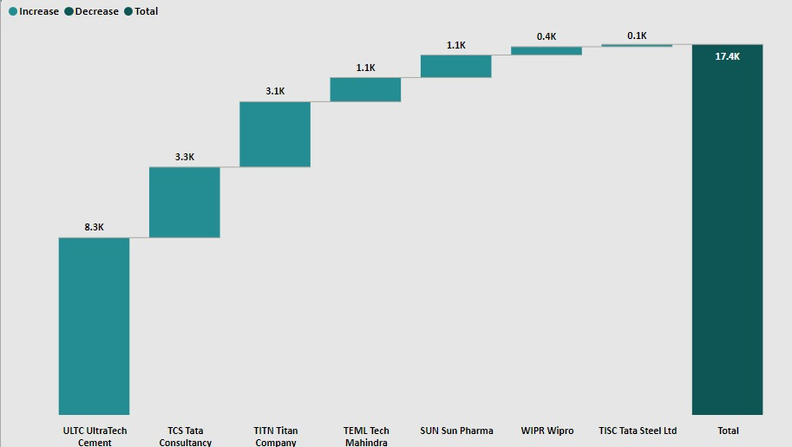
WaterFall Model

Slide 16
Thanks By Rutika Warge

